Slide 1

An introduction to statistics
Lecture 7 (probability cont.)
By/ aly maher abdelfattah

Slide 2
Important Terms
Independent Events
Two events A and B are independent if the occurrence of one does not affect the probability of the occurrence of the other. (Several events are similarly independent if the occurrence of any does not affect the occurrence of the others.) If A and B are not independent, they are said to be dependent.
Conditional Probability
P(B| A)=0.9 represents the probability of event B occurring after it is assumed that event A has already occurred (read 𝑩|𝑨 as “B given A.”) 𝑷(𝑩| 𝑨) Probability that you will success in the exam given that you did not study 0.3

Slide 3
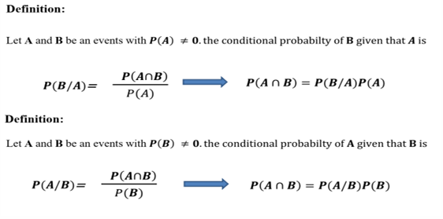
Conditional probability

Slide 4
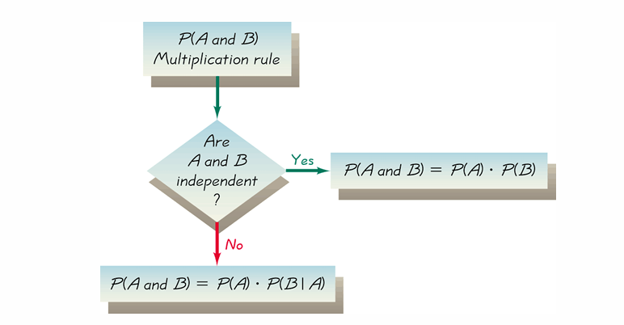
Conditional probability

Slide 5
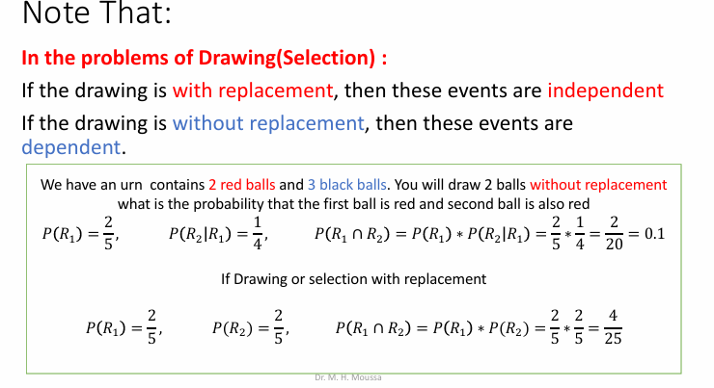
Conditional probability

Slide 6
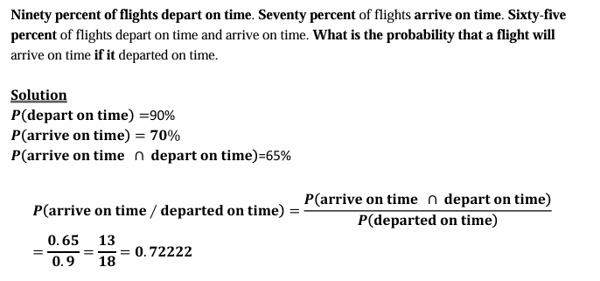
Conditional probability (example)

Slide 7
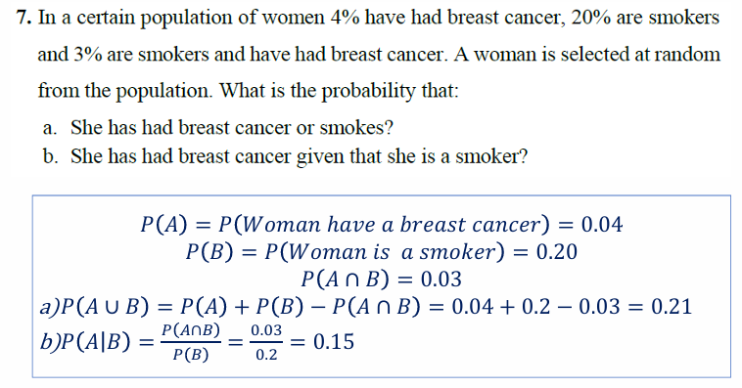
Conditional probability (example)

Slide 8
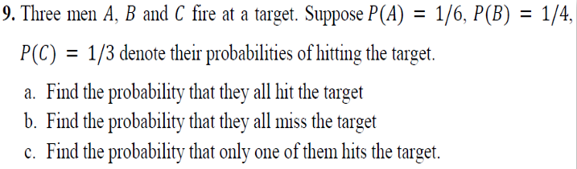
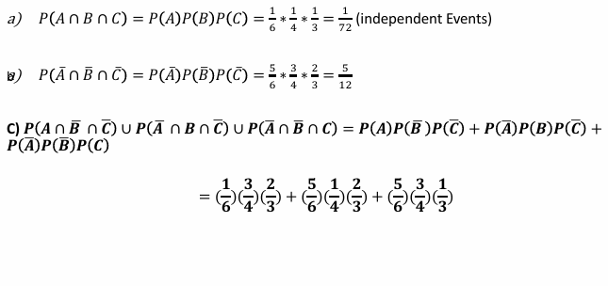
Conditional probability (example)

Slide 9
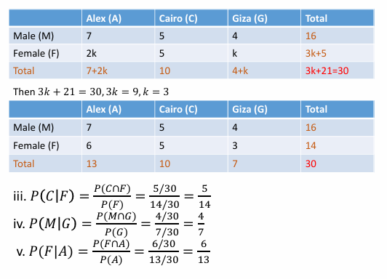
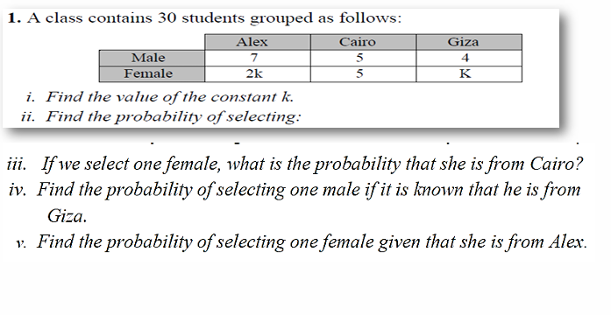

Conditional probability (example)

Slide 10

Thank you

